Slide 1
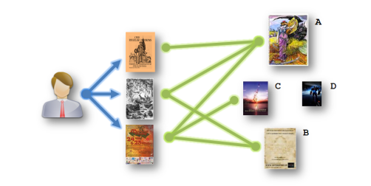
Comparative Analysis of various types of Recommendation Schemes for e-Commerce Systems
By:
Rajan Gupta

Slide 2
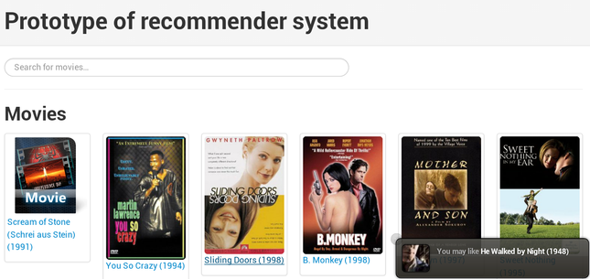
Recommender System

Slide 3
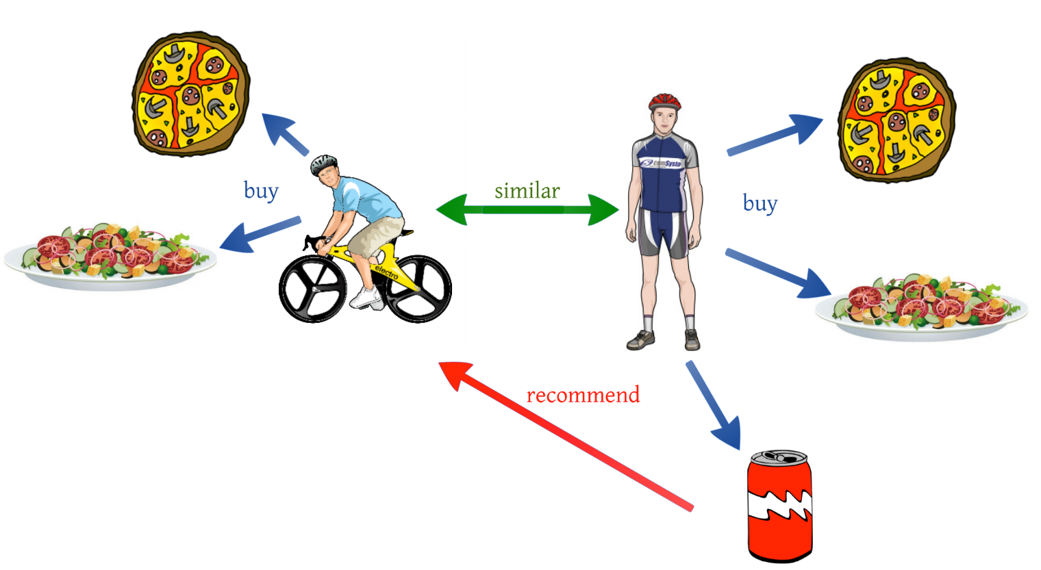
types of recommendation System
Collaborative Filtering

Slide 4

types of recommendation System
Content Based

Slide 5
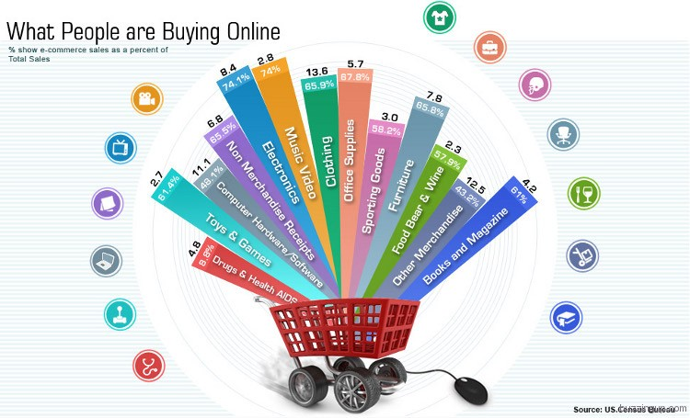
Application

Slide 6
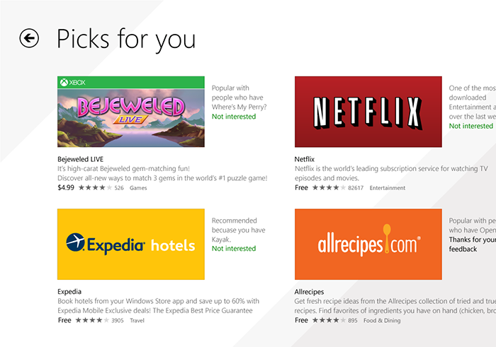
Classify your recommendations

Slide 7
Similarity Types
Item Based
User Based
Random Based
Popularity Based

Slide 8
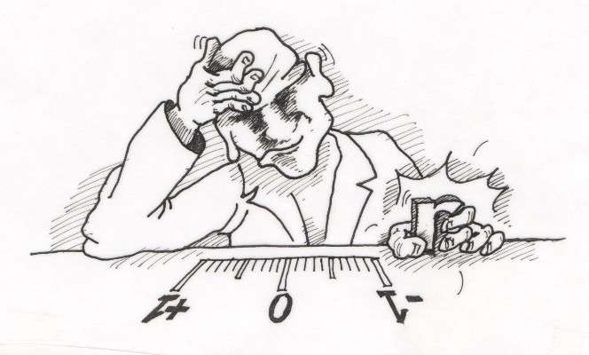
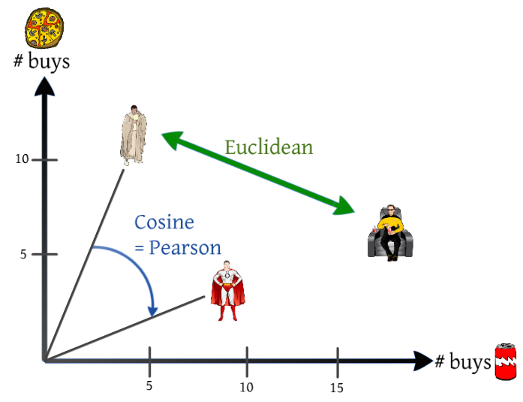
Similarity Check

Slide 9
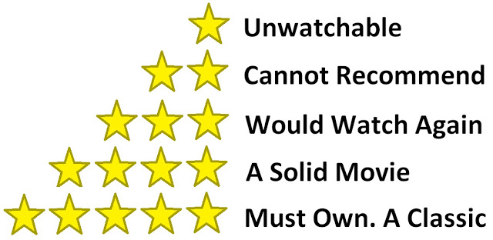
CASE STUDY Problem

Slide 10
Data description
944 Users
1682 Movies
1,00,003 Ratings
339 Movies & 64819 ratings in dataset based on Minimum 100 ratings

Slide 11
Three-fifths of respondents have shown favorability in purchasing Movie 50
Top 10 - Movie purchases
Data description
% of Respondents
Source: Online Movie Purchase Data
Base (n): 943
Notes:
User 543/943*100 = 62% users purchased movie 50

Slide 12
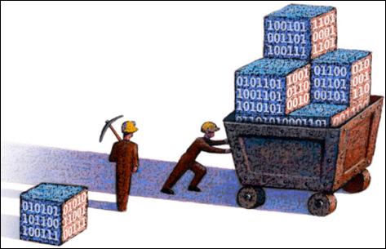
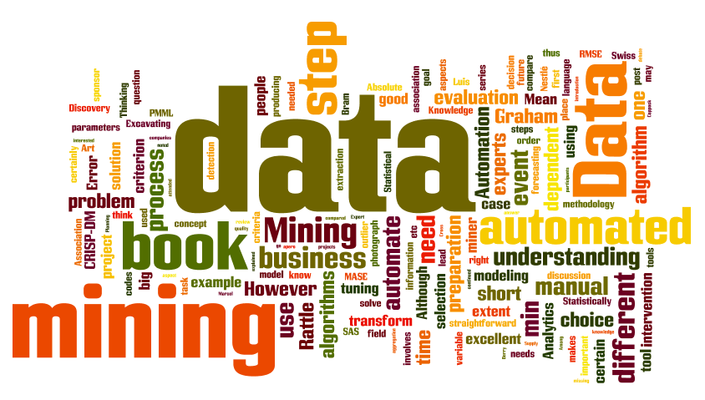
PYTHON CODES

Slide 13
Half of the respondents shown interest in purchasing Movie “181” along with Movie 50
Data description
Movie 50 purchased with Other Movies: Top 10
Source: Online Movie Purchase Data
Base (n): 943

Slide 14
Association Rules
RULE | SUPPORT | CONFIDENCE | LIFT
{174,181,50}=>{172} | 0.311771 | 0.872404 | 2.241625
{174,181}=>{172} | 0.312831 | 0.862573 | 2.216366
{174,50}=>{172} | 0.335101 | 0.831579 | 2.136727
{172,181,50}=>{174} | 0.311771 | 0.933333 | 2.095556
{172,181}=>{174} | 0.312831 | 0.930599 | 2.089417
{172,50}=>{174} | 0.335101 | 0.915942 | 2.056508
{405}=>{121} | 0.33298 | 0.912791 | 2.006437
{174}=>{172} | 0.346766 | 0.778571 | 2.000525
{172}=>{174} | 0.346766 | 0.891008 | 2.000525
{50,56}=>{174} | 0.306469 | 0.875758 | 1.966284

Slide 15


